Slide 1

My Capstone Project: Creating a Classic Arcade Game
By Fahad Hussain

Slide 2


Why Pacman Was Chosen
Planning
Research throughout the year

Slide 3
Game Design
How the game was designed/planned
Tools used to design the main components
The Language chosen
Why the chosen Language was changed
Why Finite State Machines were chosen as the primary way to control components of the game

Slide 4
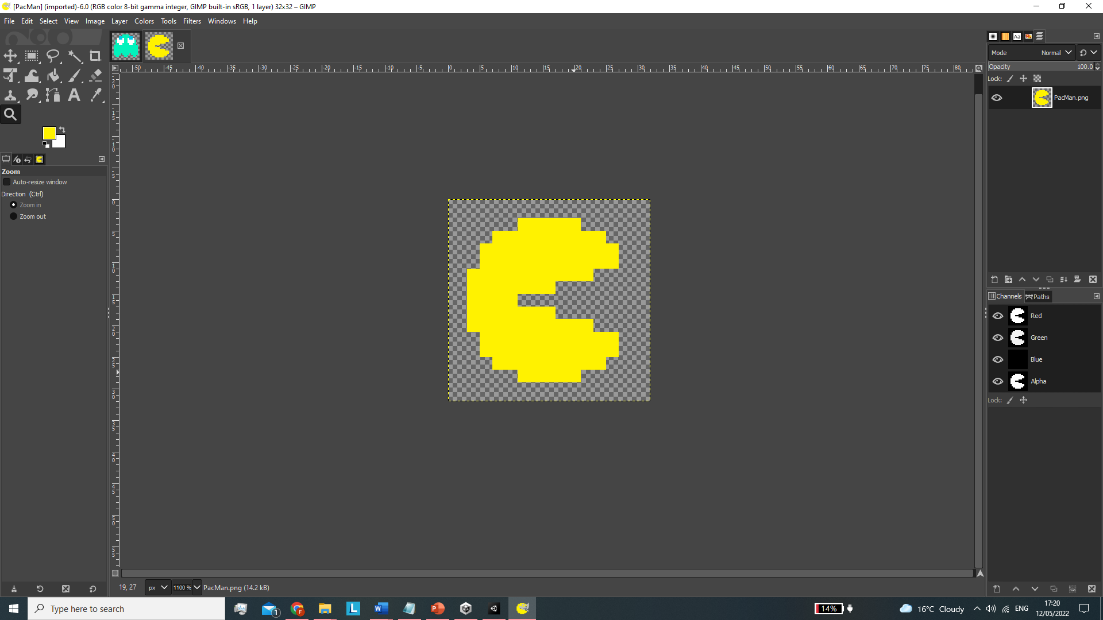
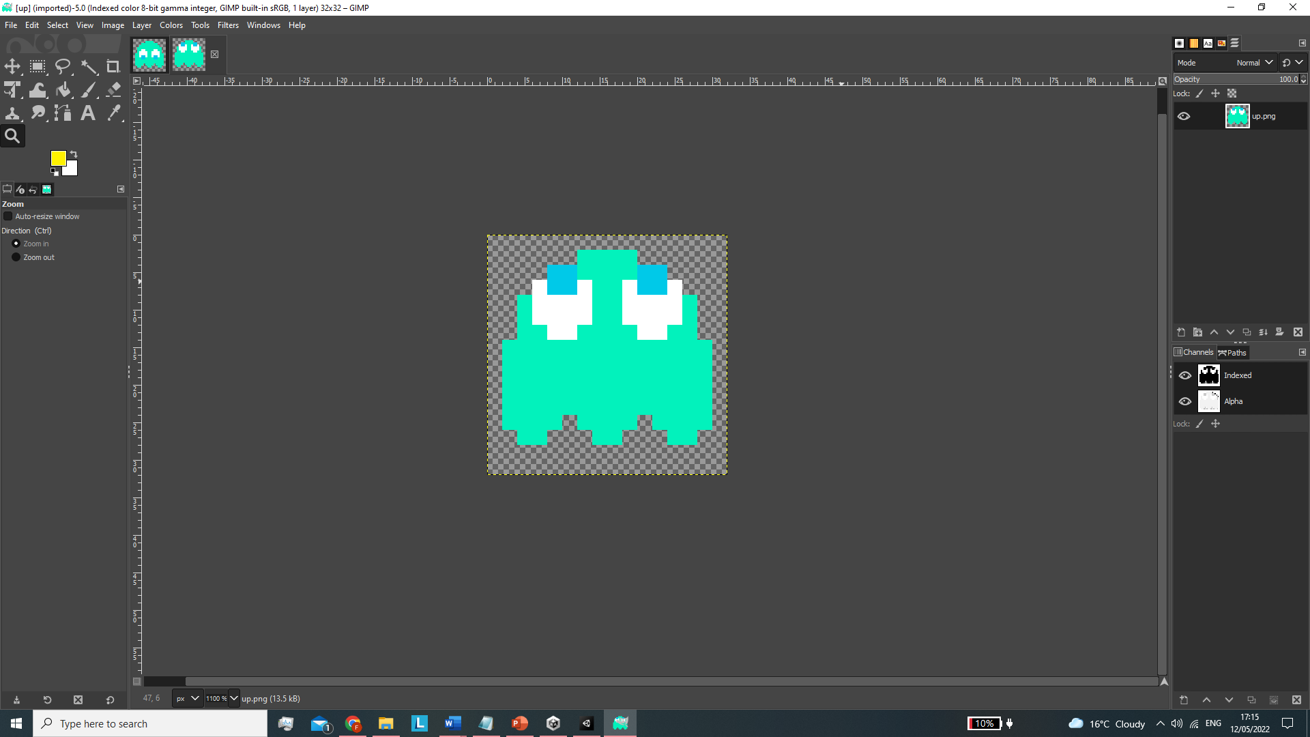
How Sprites Were Created
Sprites were created pixel by pixel through the use of the application Gimp
PacMan’s three sprites
PacMan’s death sprites
Ghosts have four different directions
8 movement sprites have to be made for each ghost
Sprite for scared mode + flash sprites

Slide 5
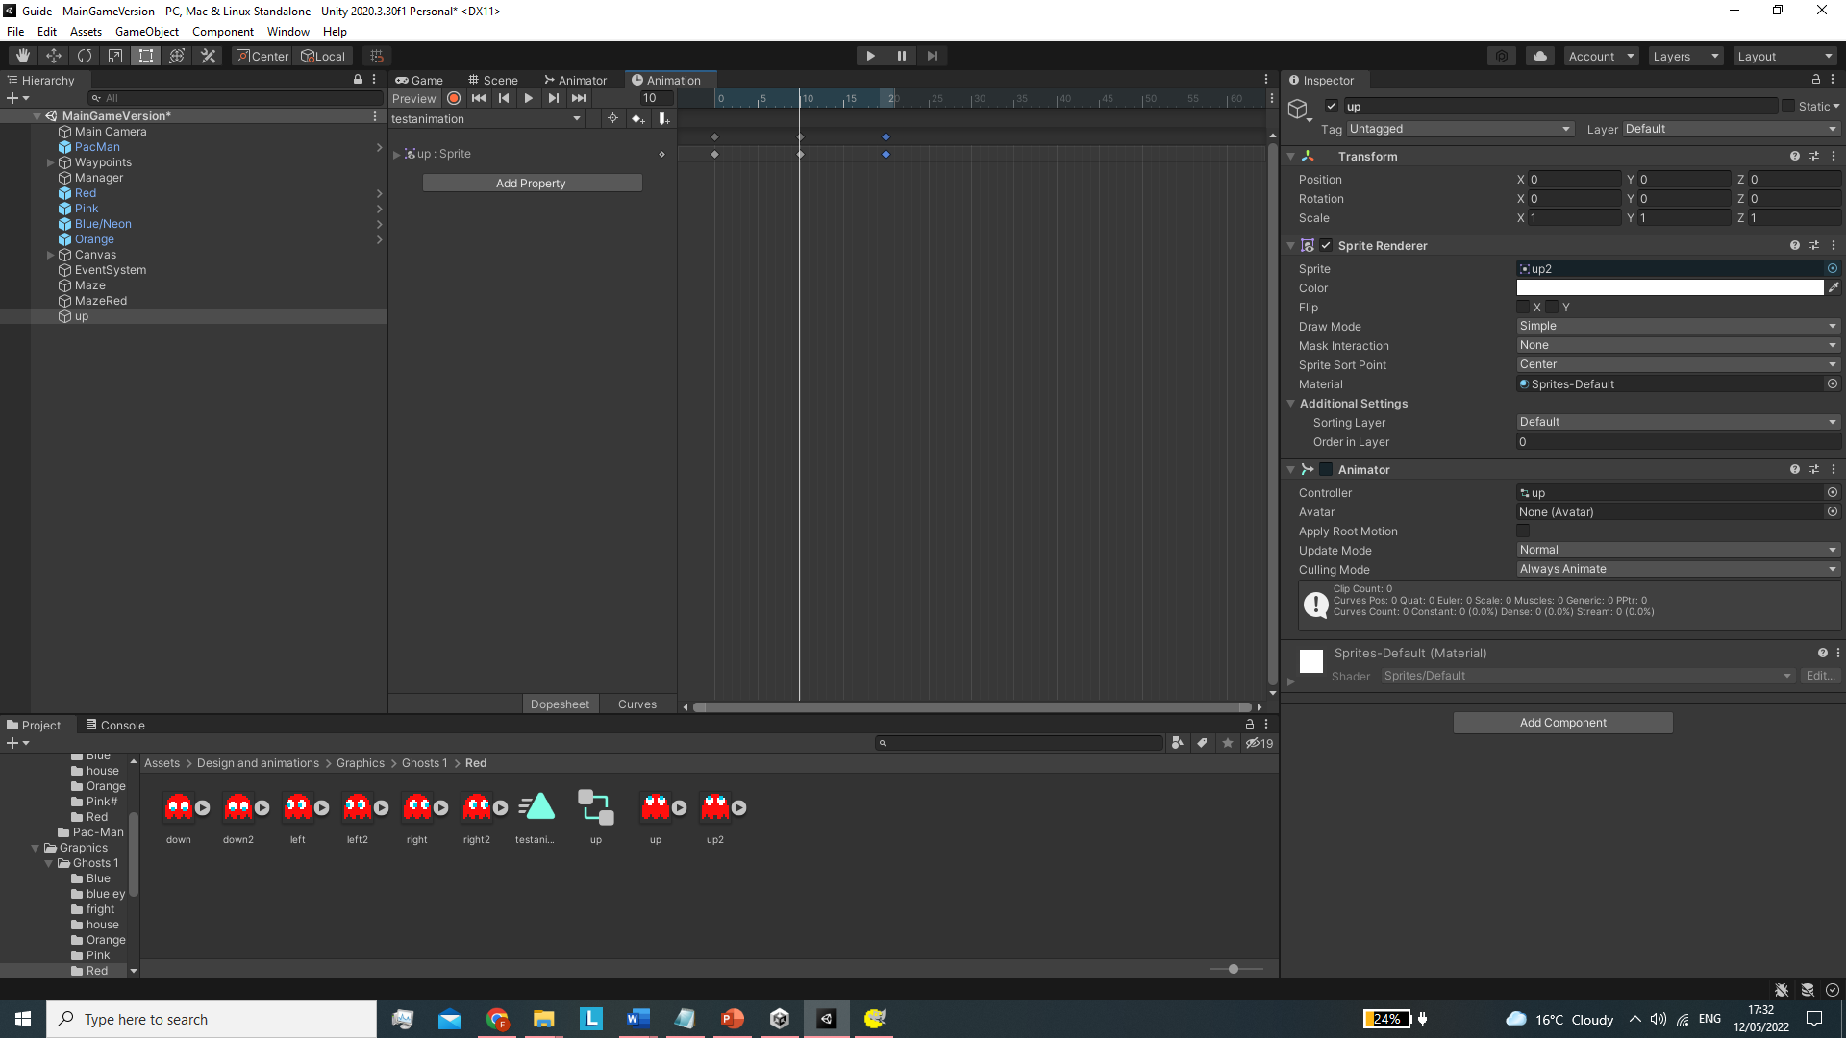
Animation
How animations were created
The two animation clips for pacman
Eating and death animation
Four movement animation clips for each ghost
The scared state animation plus the flash animation

Slide 6
The Primary Parent classes (Game Objects)
The Classes that control key aspects of the game
There are Three important game objects that help control most components of this game
PacMans Game Object
Ghosts Game Object
Managers Game Object
These all use similar helper/get methods

Slide 7
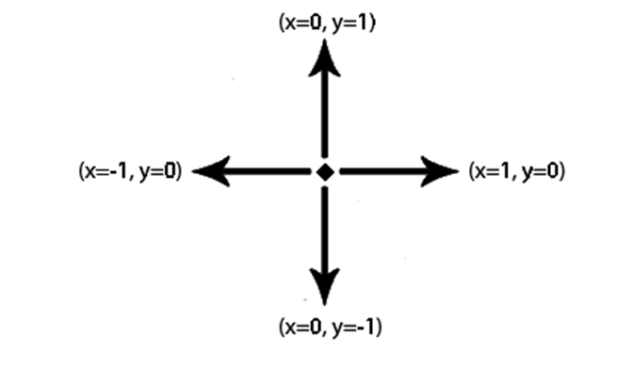
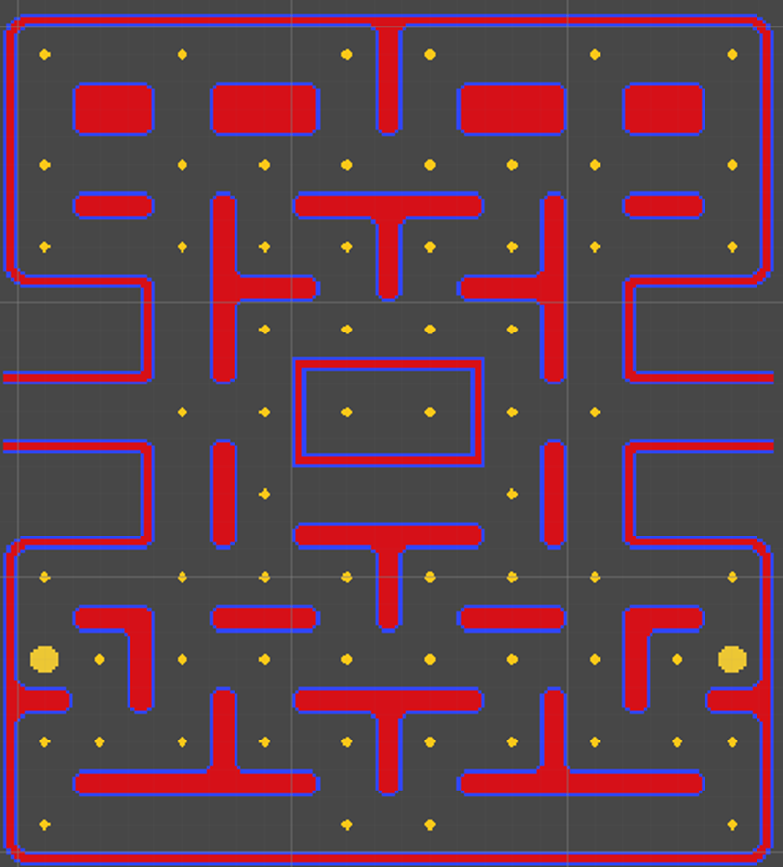
How Objects Move
Vectors
Waypoints
Waypoints are placed at intersections
Each waypoint has an adjacent waypoint
This helps control movement
Each waypoint has a vector space
How it was planned

Slide 8
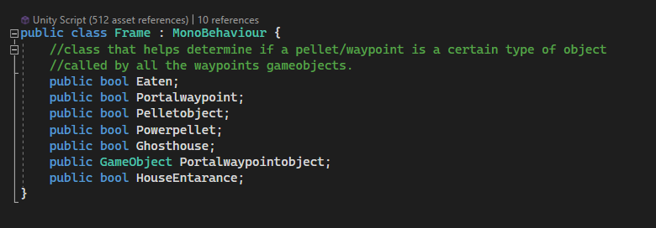
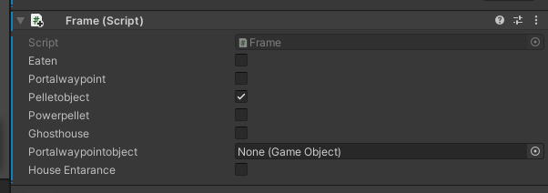
Frame Class
This is assigned to each pellet
It is used to differ between different game objects like Pellet or Power Pellet
Also used in the portal class to help objects traverse between portals
Is used for the ghost house/ house entrance
Is also used to make pellets disappear when PacMan eats a pellet

Slide 9
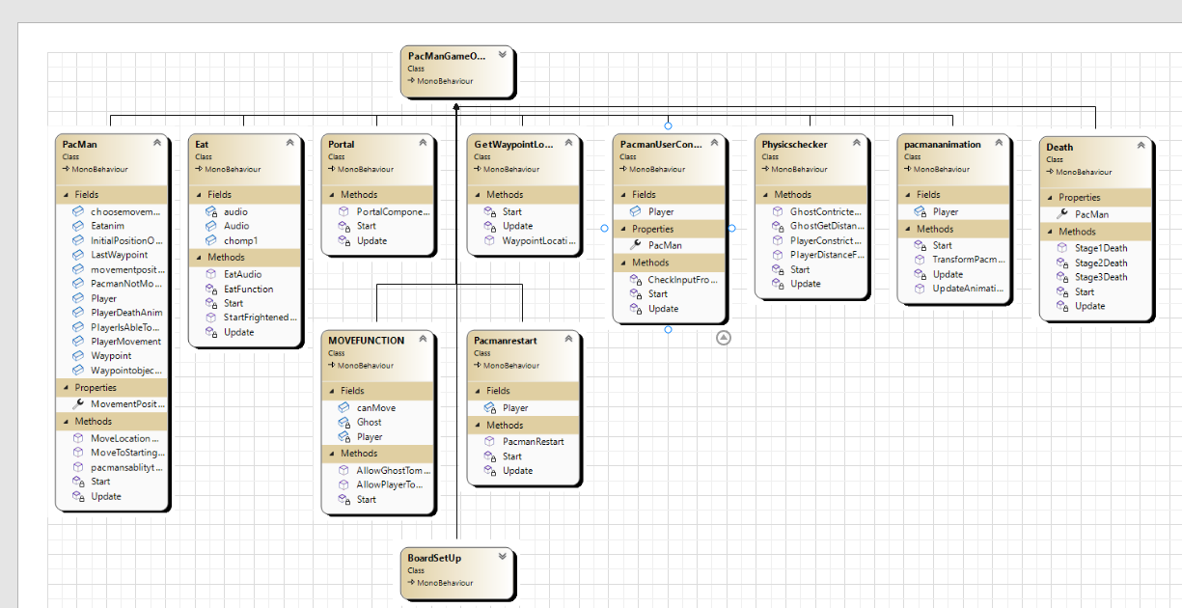
PacMan’s Game Object

Slide 10
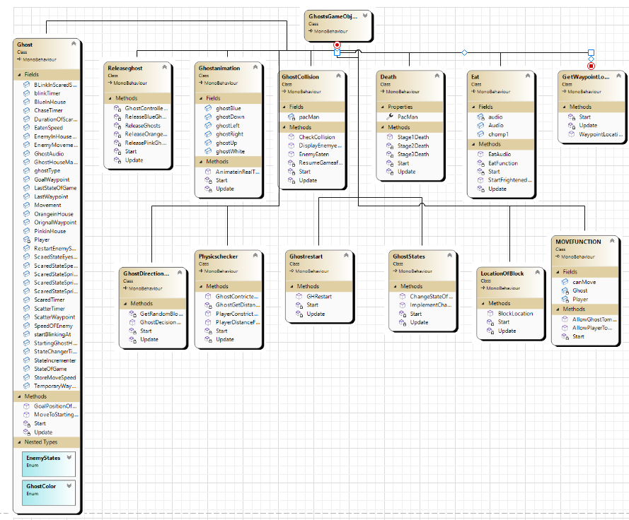
Ghost Game Object

Slide 11
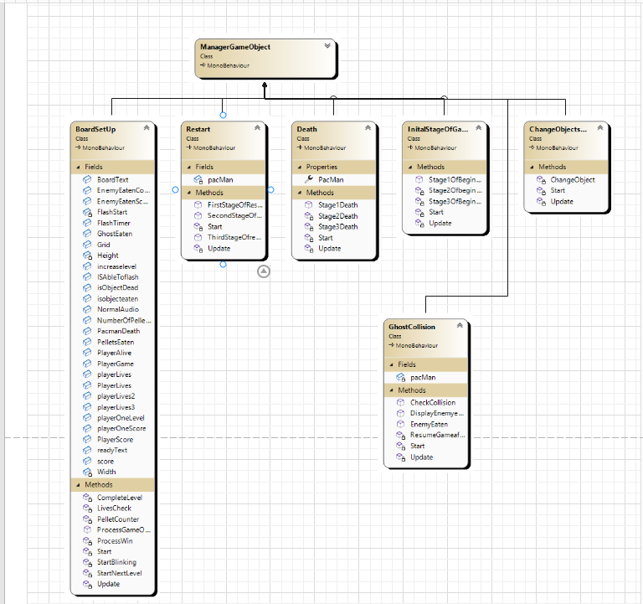
Manager Game Object

Slide 12
What MonoBehavour is
Each script that is created in unity using the language C# generally inherits from a class called MonoBehaviour, it is the base class that most scripts in unity derive from. MonoBehaviour has several prominent features that are used throughout my project, the most common one would be GetComponent, as this public method is used to retrieve important aspects of different objects in the game. For example, in the Ui section of my code whenever a text or image would need to be displayed, sprites/animation and movement must be disabled to show important components, these are placed throughout different scripts, like PacMan’s ability to move which is in the base PacMan class, this is then accessed through the use of the GetComponent method, this method is extremely useful in manipulating key fields throughout my game.

Slide 13
PacMAn’s Class
Key components in making the PacMan’s game object function as intended
How PacMan moves in the game
There are three stages for movement
Portal Component
How PacMan consumes pellets

Slide 14
Components needed to make PacMan Move
First, there is a check by the method pacmansabilitytomove() to see if there is an available vector direction that the user can go in
The second method needed uses the first method to help determine if PacMans is able to change positions to the vector direction that has been inputted by the user
The third method is needed to move PacMan continuously and constrict his movements within the confines of the maze
This is done through helper methods

Slide 15
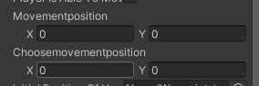
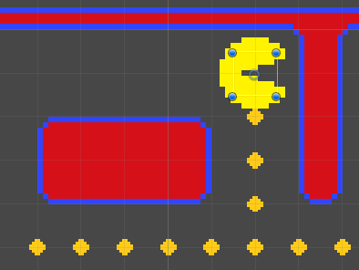
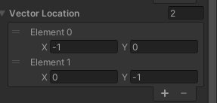
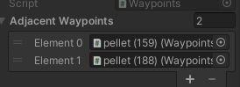
Explaining the AllowPlayertomove() function
This is based in the movefuncion script
It allows the user to reverse directions
It calls upon the method PlayerConstrictedWaypoint (will be discussed in the helper/getter section)
Pacman will carry on moving until he reaches a waypoint that does not allow him to travel In the vector direction he is going in
PacMan can only change direction once PlayerConstrictedWaypoint is true
The field ChooseMovementPosition essentially stores what a user has inputted then will change the movement of PacMan when the object has reached a waypoint

Slide 16
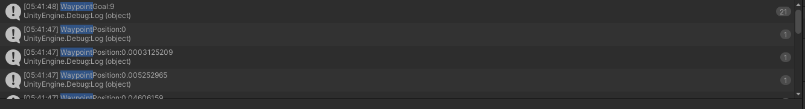
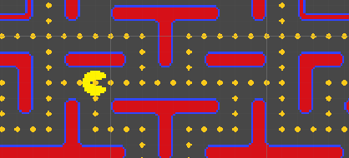
Explaining PlayerConstrictedMovements
Waypoint Position Starts off at zero
Waypoint position updates every instance PacMan’s moves
There is a waypoint Goal as illustrated
So once Waypoint Position becomes Greater than the waypoint Goal position, we constrict PacMan’s Movements

Slide 17
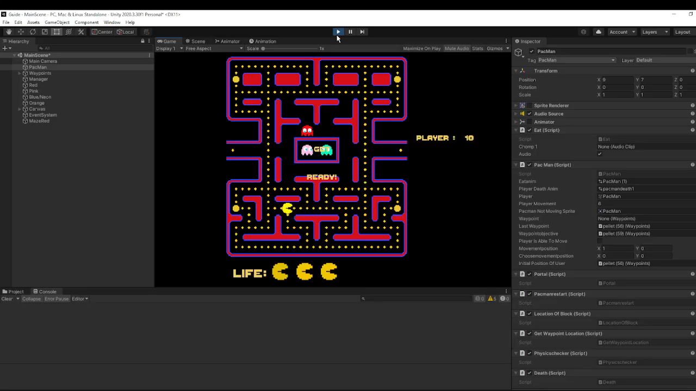
Explaining PlayerConstrictedMovements (Example)

Slide 18
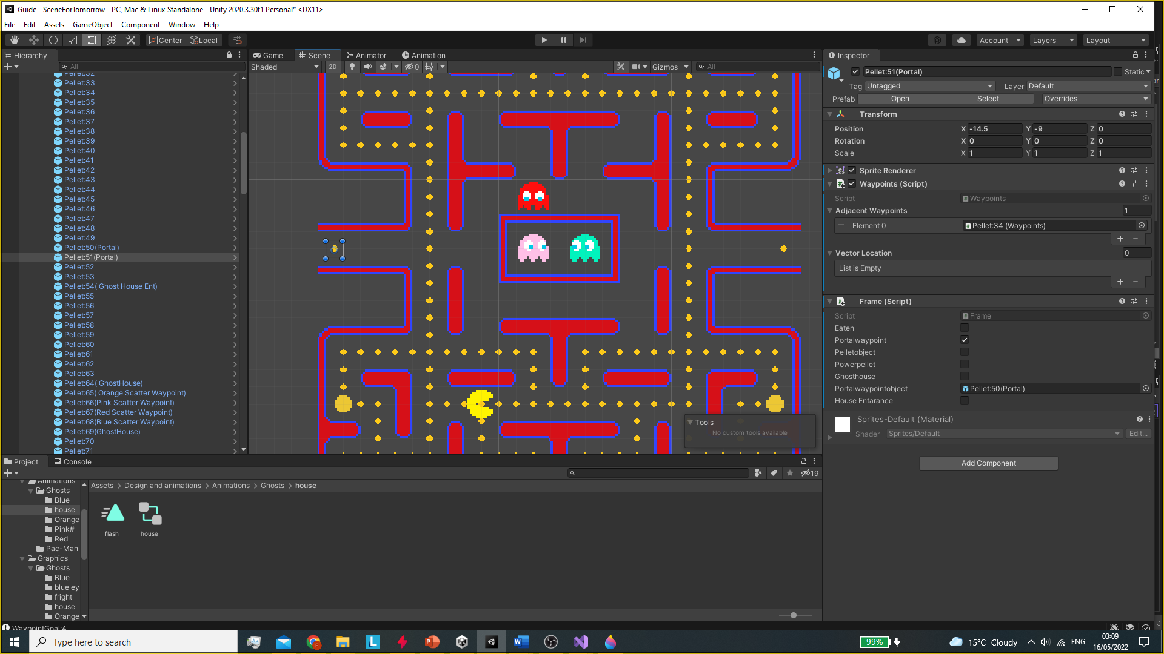
Portal Component
As you can see Pellet:51 (Portal) uses the Frame class to assign Pellet:50 as its portalwayobject.
This then uses the waypoint class and the function transform position to help transport both PacMan and the ghosts across each portal

Slide 19
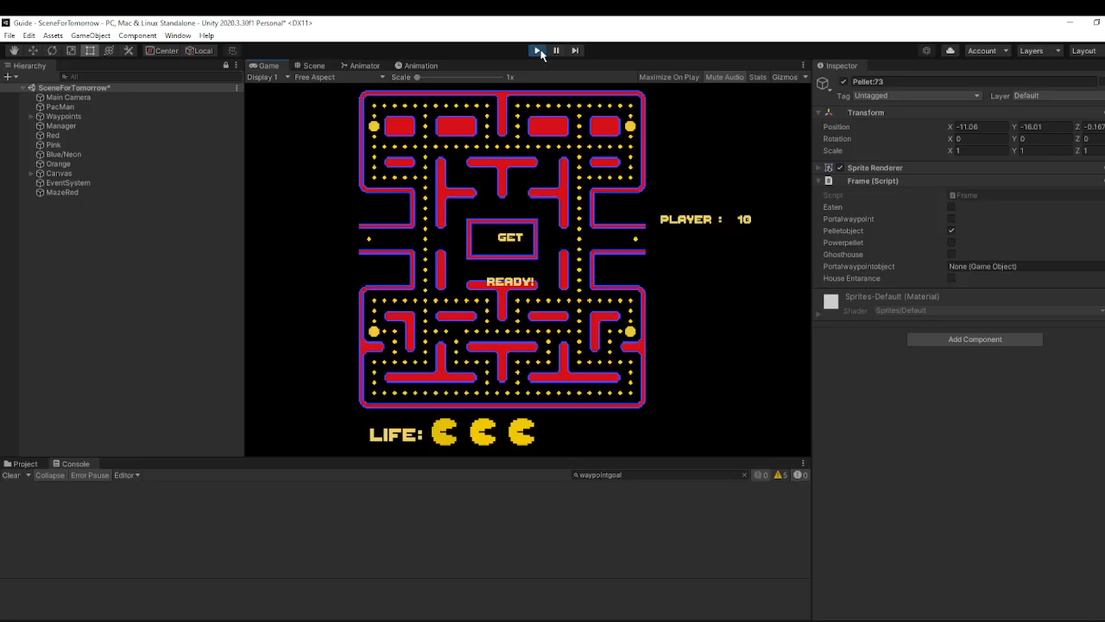
How PacMan Consumes a pellet

Slide 20
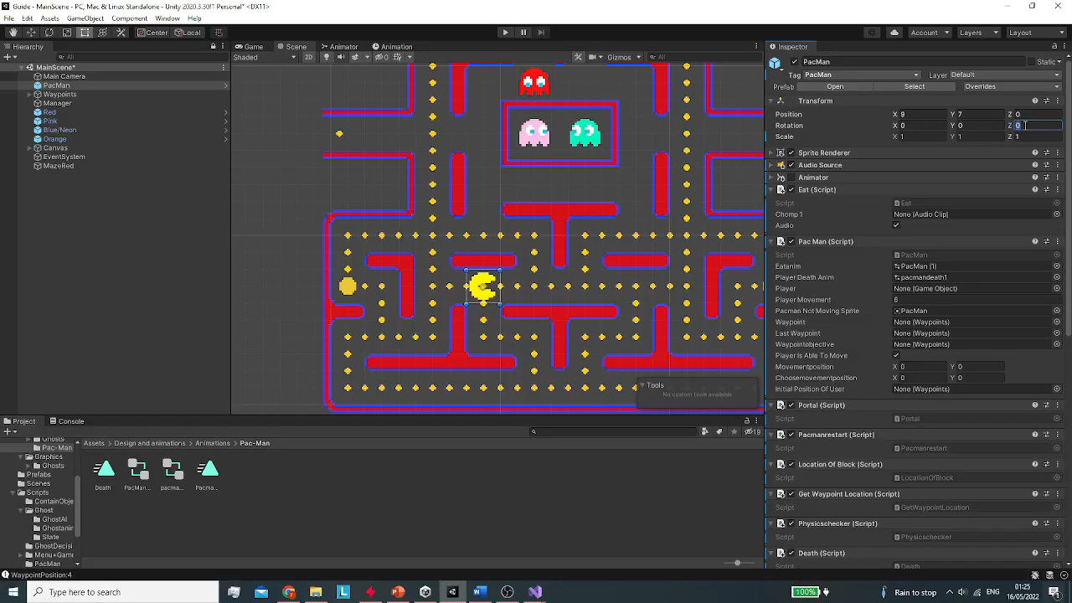
PacMans animation class

Slide 21
Ghost
Ghosts Main Class
There are Several scripts that manipulate ghost behaviours in this game
They are all assigned to the specified Ghost game object
One that controls that states of the ghost
A class that controls the ghosts A.I
when to release ghosts from the house
One Class that controls collision
Class that controls the decisions

Slide 22
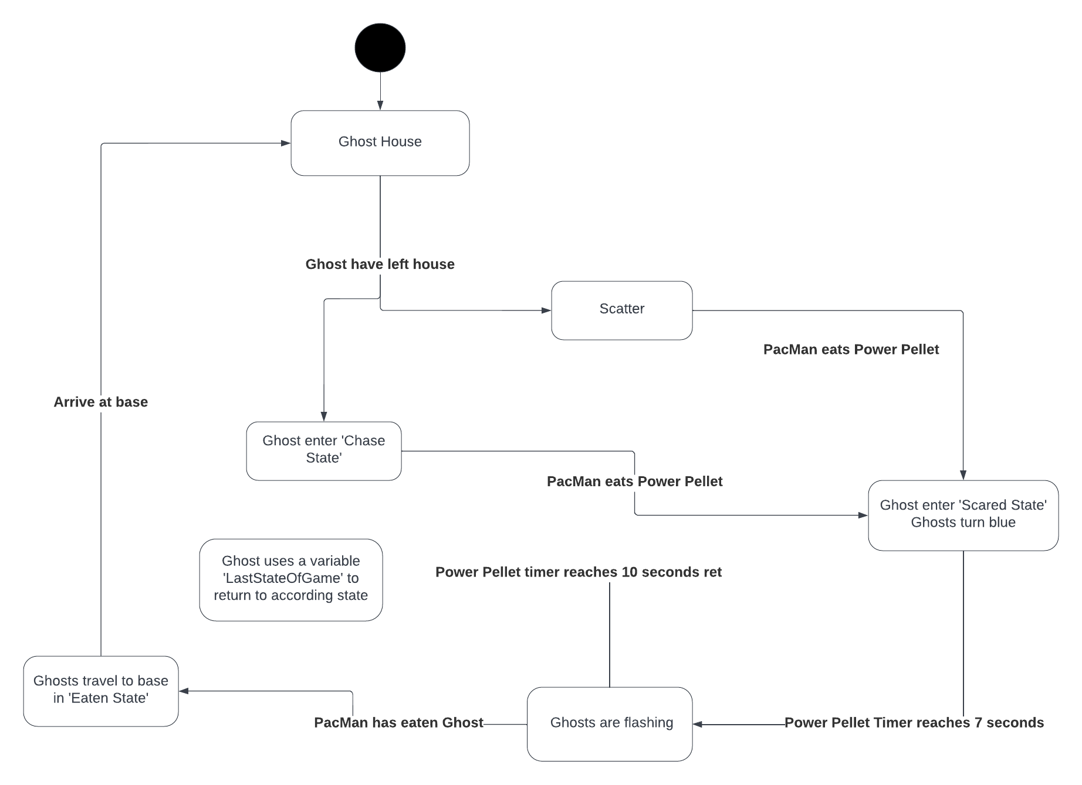
Ghost States
Two main functions
One to check what states the ghost are in, then a timer is incremented to change between the four possible states
Other function is to store the speed of the ghosts when they transform into the scared mode, it also is used to change the state of the ghosts to the determined state.

Slide 23
Ghost A.i
Each Ghost has four different A.Is
Uses State Machines to determine which colour a ghost belongs to
This is used to determine what A.I Method a ghost will use
Red will target PacMan and chase him endlessly
Pink will target the position that is four blocks ahead of PacMan
Orange will only chase PacMan if he is 8 blocks away from him otherwise it will target its scatter waypoint
Blue’s A.I is much more random than others, it will try to ambush PacMan
These Methods are then called by Ghost Direction Decision to determine what ghost goes where

Slide 24
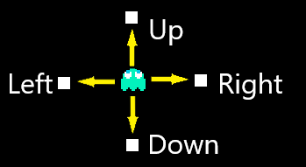
Ghost Direction decision
Ghost Direction Decision contains two methods
The first method essentially controls how ghosts traverse throughout the maze, This method uses several other scripts to function
Uses a switch case methodology to determine what goal position the ghost will have
It then uses arrays to store the ghosts current waypoint and vector movement
A built in distance formula in unity is used to calculate how far the ghosts current waypoint is from its goal position.
Then it picks the most appropriate waypoint by looping through all the available waypoints.

Slide 25
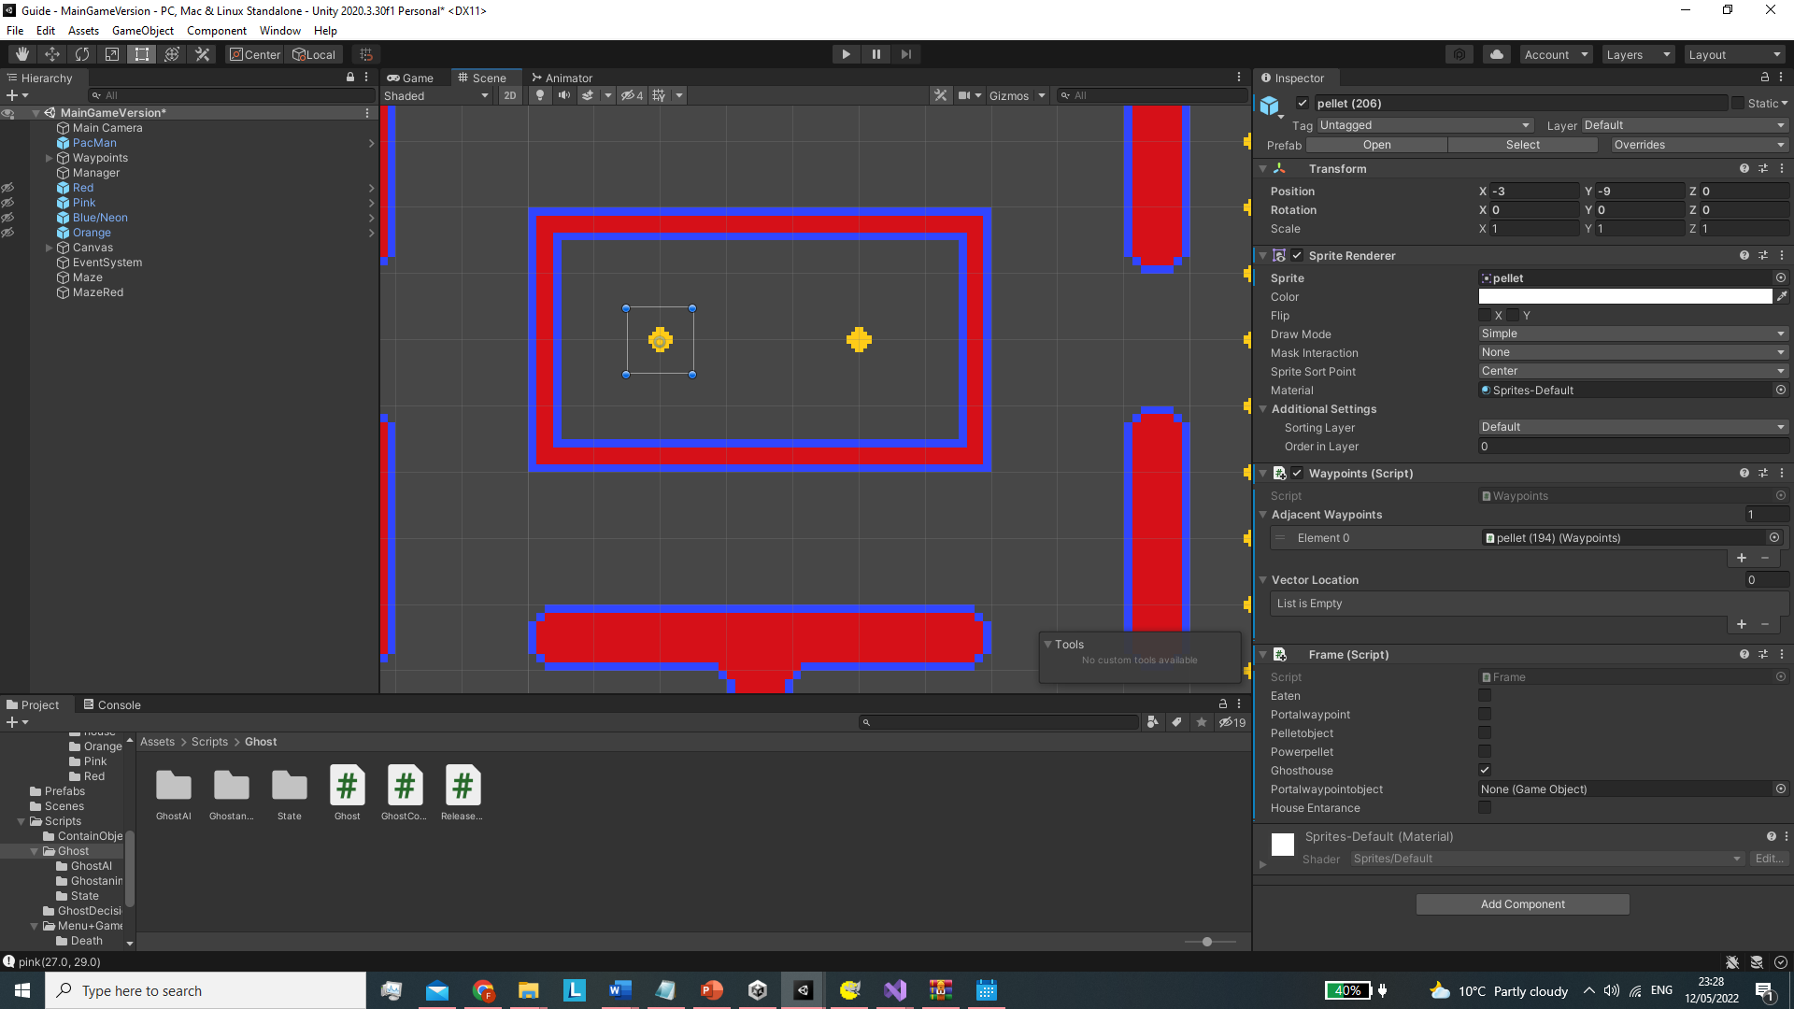
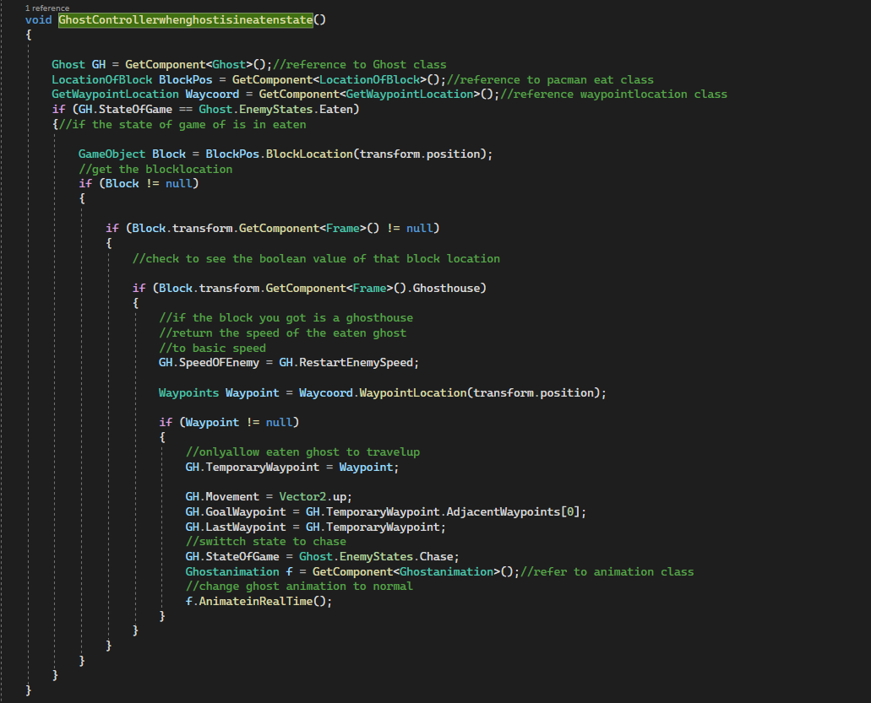
Ghost House
What the Game will do when a ghost is eaten and returns to the ghost house
How long to keep each individual ghost in the Ghost House for.

Slide 26
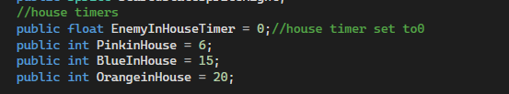
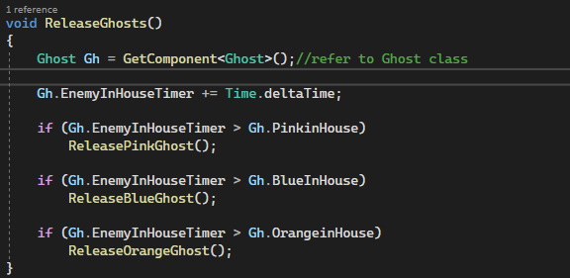
How Ghosts will be released from the ghost house
Once the EnemyInHouseTimer reaches the determined timer set in the base ghost class, it will then releasethe ghosts in order.

Slide 27
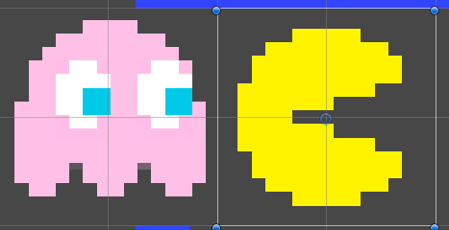
Ghost Collision
The three main functions of this class
How the bounding box for the ghost and PacMans objects are defined
Why the rectangle defined is so small

Slide 28
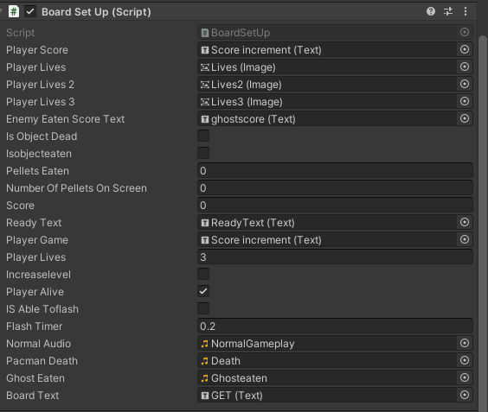
UI/Board Manipulation
This Class is responsible for displaying basic information to the user and updating the U.I efficiently.
It also keeps track of pellets
Processes what to do when the level is complete.
There are three main components it controls
These functions are controlled through Coroutines and IEnumerator
A coroutine is a common method that can pause a certain command and allow the user to control certain components for a specified number of frames.
IEnumerator allows you to stop the process at a specific moment,

Slide 29
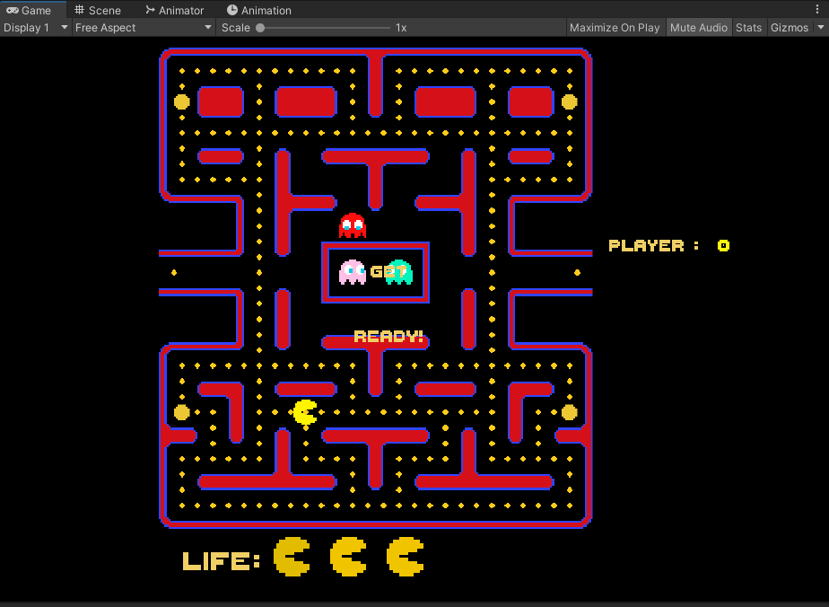
Initial Stage OF Screen
There are three stages
Each manipulated through Coroutines
First stage disables movement and sprites of Ghosts and PacMan so text is the only thing that displays
Second stage enables PacMan’s sprite and the Ghosts sprites
Third stage allows movement of PacMan and Ghosts, it also disables the texts on the board.

Slide 30
Restart
Three stages of restart
Usually occurs when Pacman has died
Calls upon PacMan restart and Ghost Restart
Places Ghost and PacMan to their original positions
Checks to see how many lives are left of player
If lives are 0 then it processes the gameover function which is in the base Board set up class
Otherwise it processes the second stage of restart.

Slide 31
Death
Three stages to Death Class
Stage 1 Death is called upon by the Ghost collision class when a ghost who is in a state that isn’t in either scared/eaten state overlaps Pacmans bounding box, this then calls the death class to begin
In Stage 1 it disables movement of both ghosts and pacman, stops any any animation from occurring and disables any sound, it also stops any coroutines from occurring.
In Stage 2 it disables sprites of each ghosts in the current game
In Stage 3 it finds PacMan’s gameobject and transforms its local scale and rotation to look flat as it is the best way display the death animation
It also calls upon the runtime animator controller and animator class to enable the correct death animation, it plays the PacMan death audio.
Finally the Coroutine starts and enables the third stage of restart, which will check how many lives PacMan has and act accordingly.
Example of video in next slide

Slide 32
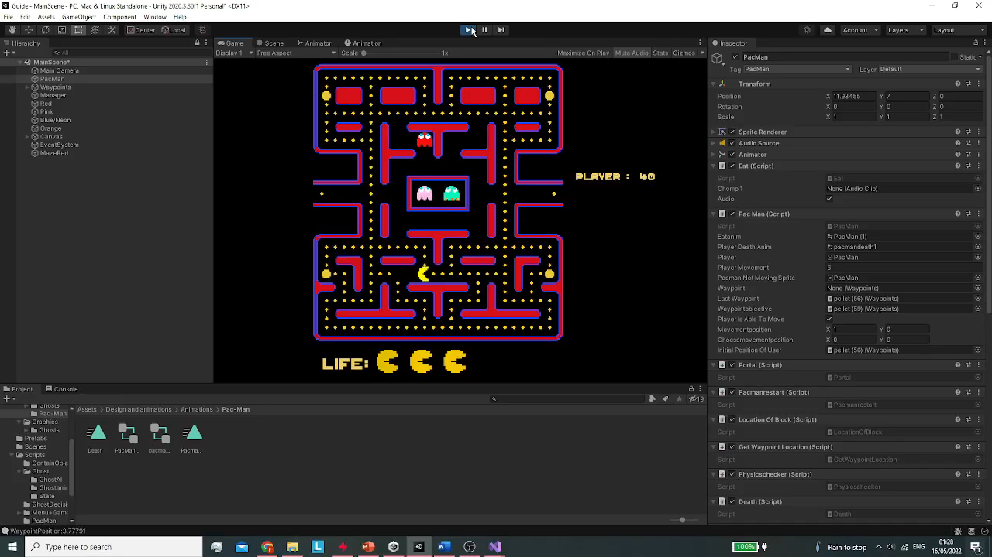
Example Of Death Video

Slide 33
Helper/Getter Methods Used
Location of block
This was used to find what components a block may have
Get Waypoint Location
This was used to find location of a specific waypoint
Physics checker
In GhostDirectionDecision class (GetRandomBlockForFrightenedMode())

Slide 34
Bugs/ Problems I had faced
Bugs
Blue ghosts eaten sprite would play when in a scatter/chase state
PacMan’s Death animation would not play
PacMan sprite would turn tiny when moving around the map
PacMan would go invisible when reaching a wall
Ghosts would not leave the house
Ghosts would not follow movement pattern
PacMans can go into the house
Portal right would make Pac man get stuck
Inserting adjacent waypoints in the maze
Timing Enumerators to be accurate to real time
Object reference error (common)
PacMan not moving efficiently, Gameplay felt slow and choppy.
Ghosts not turning blue when in scared state
Ghosts would consume pellets
Checking to see if Red A.I pathing algorithm works
Checking to see if Pink’s A.I pathing algorithm works
Checking to see if Blue’s A.I pathing algorithm works
Checking to see if Orange’s A.I pathing algorithm works
Manipulating speed of ghosts

Slide 35
Features that were included but had to be removed
Pellets around the centre of the maze
Bonus items
Difficulty

Slide 36



